Slide 1
Financial Modeling
Capital Budgeting and Valuation Models
Jacqueline Garner, Ph.D.
Lecturer
Scheller College of Business
Capital Budgeting Techniques: Cash Flows Given
Notes:
Hello, I’m Jacqueline Garner, and welcome to Financial Modeling

Slide 2
Before We Begin…

Slide 3
Capital Budgeting Evaluation Techniques
Several methods to evaluate capital budgeting. We will focus on just four (4):
Net Present Value (NPV)
Internal rate of return (IRR)
Modified Internal rate of return (MIRR)
Profitability Index (PI)

Slide 4
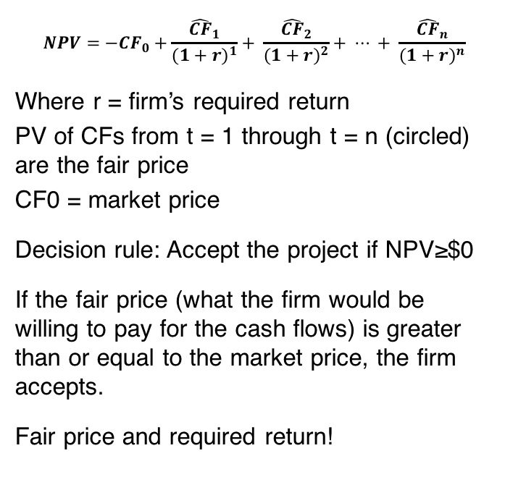
Capital Budgeting Techniques: NPV
$$NPV={−CF}_{0}+\frac{{\hat{CF}}_{1}}{{(1+r)}^{1}}+ \frac{{\hat{CF}}_{2}}{{(1+r)}^{2}}+ ⋯ + \frac{{\hat{CF}}_{n}}{{(1+r)}^{n}}$$
Where r = firm’s required return
PV of CFs from t = 1 through t = n (circled) are the fair price
CF0 = market price
Decision rule: Accept the project if NPV≥$0
If the fair price (what the firm would be willing to pay for the cash flows) is greater than or equal to the market price, the firm accepts.
Fair price and required return!

Slide 5
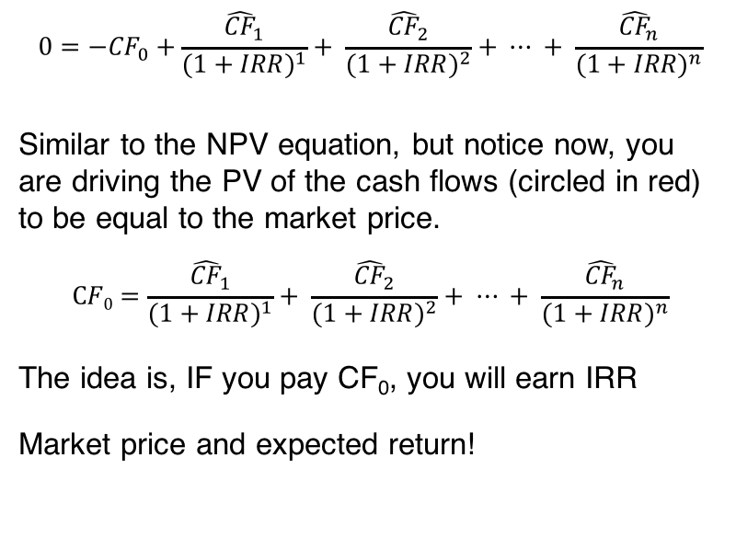
Capital Budgeting Techniques: IRR
$$0={−CF}_{0}+\frac{{\hat{CF}}_{1}}{{(1+IRR)}^{1}}+ \frac{{\hat{CF}}_{2}}{{(1+IRR)}^{2}}+ ⋯ + \frac{{\hat{CF}}_{n}}{{(1+IRR)}^{n}}$$
Similar to the NPV equation, but notice now, you are driving the PV of the cash flows (circled in red) to be equal to the market price.
$$CF0=\frac{{\hat{CF}}_{1}}{{(1+IRR)}^{1}}+ \frac{{\hat{CF}}_{2}}{{(1+IRR)}^{2}}+ ⋯ + \frac{{\hat{CF}}_{n}}{{(1+IRR)}^{n}}$$
The idea is, IF you pay CF₀, you will earn IRR
Market price and expected return!

Slide 6
Capital Budgeting Techniques: MIRR
Modified Internal Rate of Return (MIRR) is necessary when more than one sign change occurs in the cash flows for a project
Each sign change results in an additional solution to the IRR equation.
MIRR modifies the CFs so there’s only 1 sign change. Then we compute IRR.

Slide 7
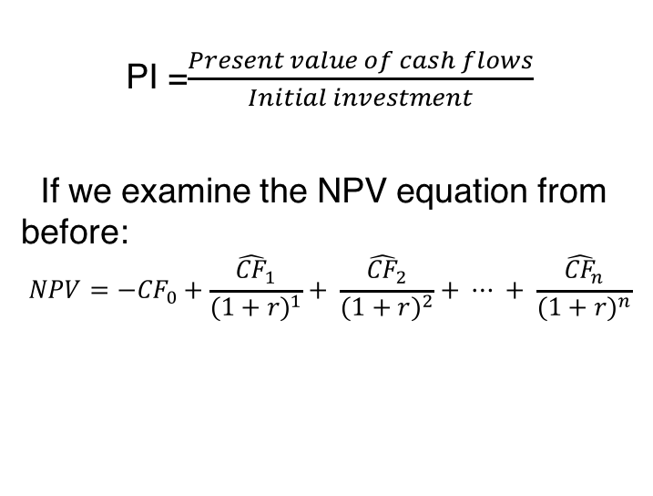
Capital Budgeting Techniques: Profitability Index (PI)
PI =$\frac{Present value of cash flows}{Initial investment}$
If we examine the NPV equation from before:
$$NPV={−CF}_{0}+\frac{{\hat{CF}}_{1}}{{(1+r)}^{1}}+ \frac{{\hat{CF}}_{2}}{{(1+r)}^{2}}+ ⋯ + \frac{{\hat{CF}}_{n}}{{(1+r)}^{n}}$$

Slide 8
Capital budgeting technique decision rules
Accept if:
NPV ≥ $0
IRR ≥ Required return
MIRR ≥ Required return
PI ≥ 1

Slide 9
Capital Budgeting Techniques
Let’s practice using the file:
Cap_Budget_Valuation.xlsx

Slide 10
Summary

